Slide 1

Power BI Project
18th Lok Sabha
Election Analysis
Gokula Krishnan

Slide 2
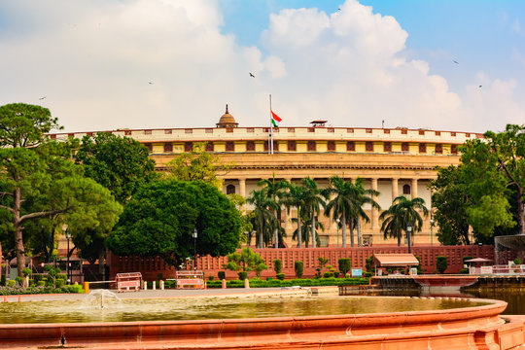
Dataset
Description
Dataset Name:
18th Lok Sabha Election Dataset
Dataset Description:
This dataset contains detailed results of the 18th Lok Sabha General Elections of India (2024), covering constituency-wise election outcomes across all 543 parliamentary constituencies. It provides structured information on candidates, political parties, vote shares, margins, and state-wise distribution of seats, enabling comprehensive electoral analysis
Tables:
Constituency-wise Election Details
Constituency-wise Election Results
Party-Wise Election Results
Indian States and Union Territories List
State-wise Election Results

Slide 3
1
Constituency-wise Election Details
This dataset contains constituency-wise election result details for candidates participating in different constituencies.
Each row represents the performance of a single candidate in a particular constituency.
Table Description
Columns:
S.no.
Candidate
Party
EVM Votes
Postal Votes
Total Votes
% of Votes
Constitution ID

Slide 4
2
Constituency-wise Election Results
This dataset contains constituency-wise parliamentary election results.
Each row represents the winning candidate from a specific constituency along with their vote count, victory margin, and party details.
Table Description
Columns:
S. No.
Parliament Constituency
Constituency Name
Winning Candidate
Total votes
Margin
Constituency ID
Party ID

Slide 5
3
Party-Wise Election Results
This dataset contains the party-wise election performance results from a parliamentary election.
Each row represents a political party and the number of constituencies/seats won by that party.
Table Description
Columns:
Party
Seats Won
Party ID

Slide 6
4
Indian States and Union Territories List
This dataset contains a list of Indian States and Union Territories along with their unique identifiers (State IDs)
Table Description
Columns:
State ID
State

Slide 7
5
State-wise Election Results
This dataset contains state-wise parliamentary election results for constituencies across India. It provides details about winning and trailing candidates, victory margins, constituency information, and election result status.
Table Description
Columns:
Constituency
Const. No.
Parliament constituency
Leading Candidate
Trailing Candidate
Margin
Status
State ID
State

Slide 8
Data
Data
Cleaning
Transformation
Candidate names are modified to proper format
Consitutencies are properly Capitalized
Combined Constituency name and its ID to avoid ambiguities.
Created Party Abbreviations from the Party Names using Power Query
Calculated DAX expression to analysis Key metrics such as Total Votes, Top Constituency, etc.,

Slide 9
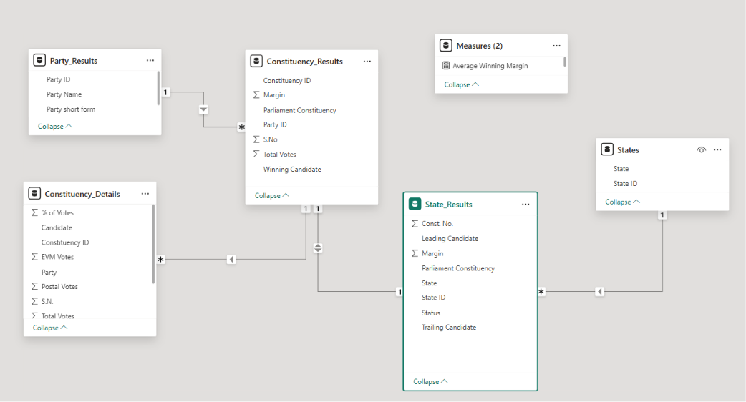
Data
Modelling

Slide 10
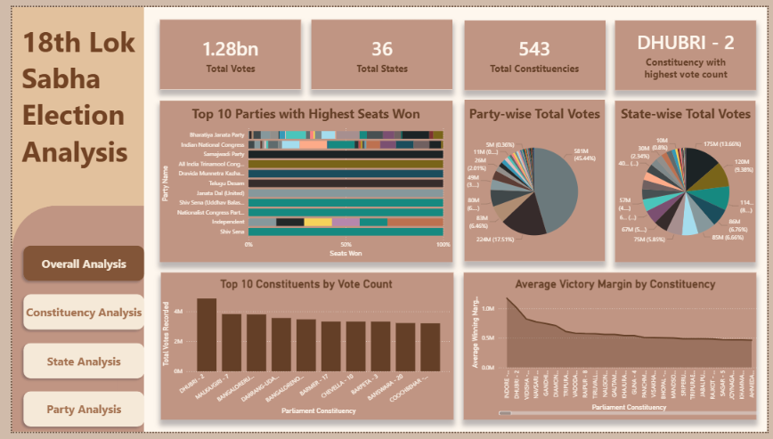
Dashboard - Overall Analysis

Slide 11
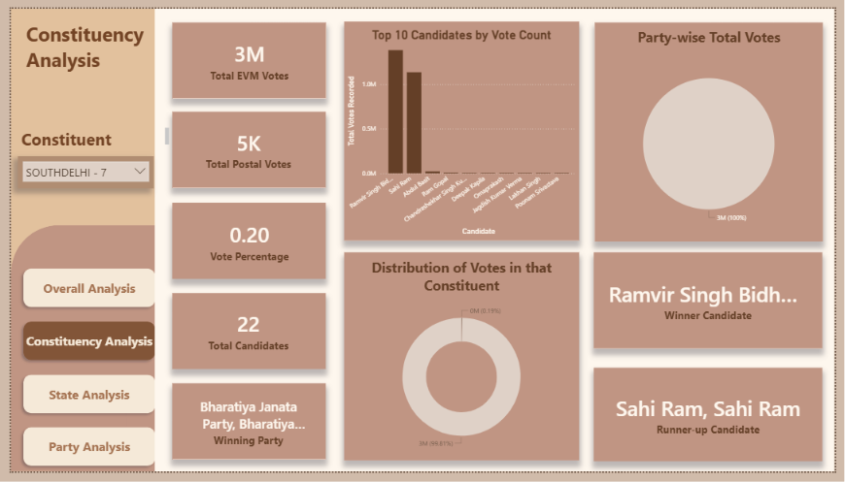
Dashboard - Constituency Analysis

Slide 12
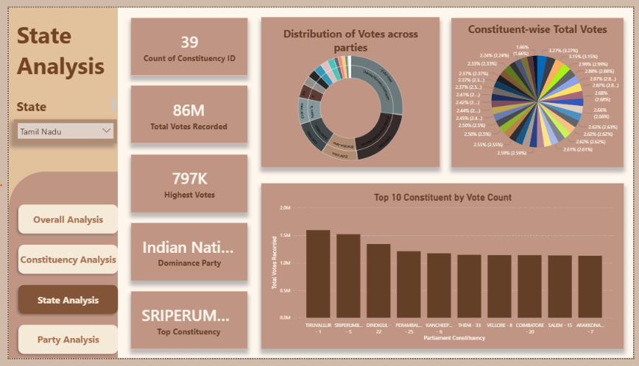
Dashboard - State Analysis

Slide 13
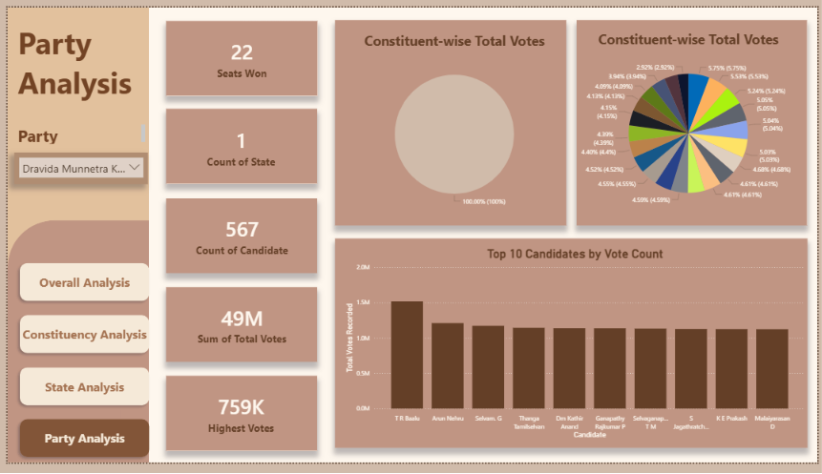
Dashboard - Party Analysis

Slide 14
1
The BJP won 240 seats, falling short of the 272 majority mark on its own. The NDA alliance together secured 293 seats, allowing it to form the government. This marked a shift from earlier elections where BJP had a single-party majority (2014, 2019).
2
The Congress party won 99 seats, its best performance in a decade. The INDIA alliance overall emerged as a significantly stronger opposition bloc.
Insights
3
North India – BJP dominance continues
South India – Opposition + regional parties strong
DMK led INDIA alliance dominated
East & Northeast – mixed but NDA advantage
4
Many seats were decided by very small margins (under 20,000 votes)
2024 saw more 3-way and 4-way contests
BJP vs INDIA vs regional parties vs independents
5
BJP dominance in Urban/Semi-Urban Constituencies
Opposition Stronger in Rural + agrarian belts

Slide 15
THANK YOU

